Slide 1
The Brain Dr. Lori Desautels
Always Changing
Experience Dependent
A Reflection of our Experiences

Slide 2
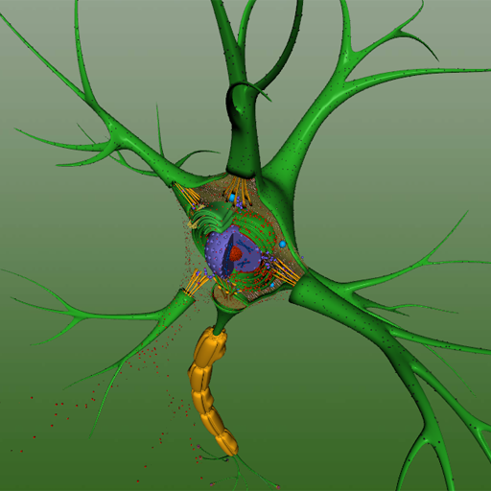
What Activates a Neuron?
Thoughts, Feelings Behaviors ( experiences)
The neurotransmitters attach to the dendrites and this results in an electric charge ( action potential) sent down the axon of the neuron!
Most neurons communicate chemically
Inside neurons is the electrical activity

Slide 3
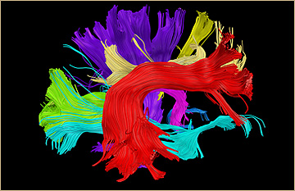
Neuroplasticity
Axons form myelin – the thicker the myelin the more efficient the system.
Axons sends electrical signals to dendrites (fingers) and they receive information creating fiber tracts that connect many parts of the brain together
When we learn , we grow more dendrites!

Slide 4
The Developing Brain
First two years of life as many as two million synaptic connections every second occur based on sensory stimulation. ( Far more connections than we will ever need)
Throughout childhood our environments refine our brains shaping it to what we are exposed to. Over time, our brains form fewer but stronger connections!
If not given the proper expected environment the brain will struggle to develop normally
Without an environment with emotional care and cognitive stimulation, the human brain can’t develop normally!
Smaller brain
Cognitive lag
Attachment affects everything!

Slide 5
Developing Brain

Slide 6
Neuroplasticity
Experience dependent
Daily experiences, relationships, beliefs, thoughts and feelings!
BDNF is secreted when we learn something new.
BDNF activates the nucleus basalis, the control center of plasticity.
NB produces learning and memory
Brain and Nervous system are widely represented throughout the body with mutual receptors
Neurons can take on new functions
Capacity of the brain to restructure itself
Capacity of individuals to change their behaviors

Slide 7
Neuroplasticity
How does NB work?
Secretes acetylcholine for supporting new structures
Dopamine rewards the learner with a sense of pleasure at the accomplishment
Doidge 2007- Exercise and new learning work hand in hand- creates new cells
Synapse- both axons and dendrites have many receptor points
23 billion cells studied from 11 cadavers
Ligands- Informational substances- chemicals neurotransmitters, steroids and peptides- these travel through the blood and spinal fluid

Slide 8
Neuroplasticity
Synaptic gaps need to be clean so calpain from calcium acts as a cleanser removing protein build-up at the gap!
Learning is the density of neuronal connections.
200 ligands –intercellular activity / our electrochemical language
Norepinephrine- acts as a printer that fixes information into long term memory- helps establish new synapses associated with memory!
Dopamine is associated with motor coordination, WM, mental flexibility, processing speed, creativity, time space reasoning

Slide 9
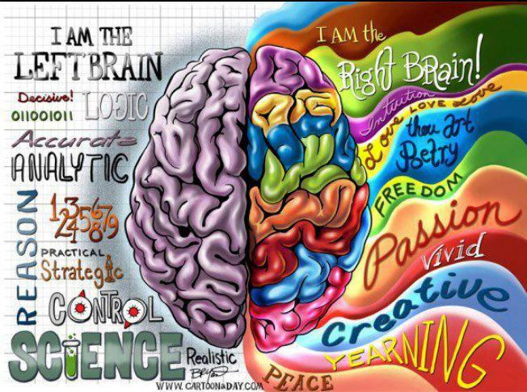
Brain Hemispheres
Language, logic, interpretation, math,
Approach behaviors
Cheerfulness
Positive emotion
Language
Dopamine
Male
GEOMETRY
Nonverbal processing
Visual pattern recognition
Spatial skills
Auditory discrimination
Avoidance behaviors
Negative emotions
Serotonin
Noradrenaline
Females use both hemispheres!

Slide 10
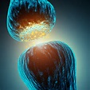
Communication and Learning
The communication between cells is our thoughts, feelings and actions
Dopamine- mood, movement, memory arousal, and motivation
Serotonin- Mood, anxiety, appetite and sleep
Epinephrine- Adrenaline, attention, helps code a memory!
GABA- Inhibitory
Acetylcholine-Attention , Learning , Memory Movement

Slide 11
Frontal Lobe- Executive Functions
Orbital PFC- inhibits emotionally inappropriate or socially inappropriate behaviors
Dorsolateral- Planning , Sequencing of Events
Hippocampus- Doesn’t store long term memory but has connections to nearly every other area of the brain!
Encodes memory
Cell growth and death
Works with Amygdala!

Slide 12
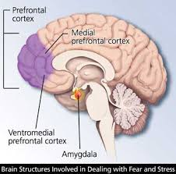
Amygdala
Emotional, memory, and association system
Produces unconscious memories
Responses in the Amygdala are felt not thought
In PTSD, the HPA axis is chronically activated which is responsible for regulating stress response!
Decreased hippocampal volumes ( 5to 26%) because of the chronic elevation of glucocorticoids resulting in a reduction of dendritic branching!

Slide 13
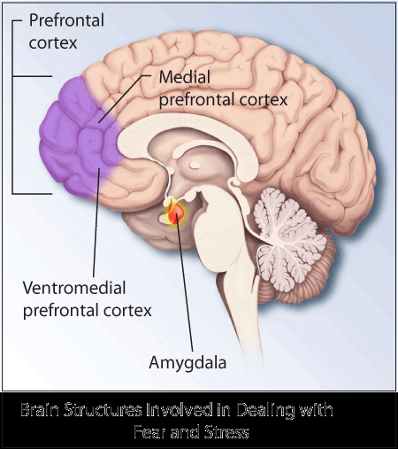
GAP
Anxiety is a huge barrier to learning
Anxiety is a learning disability/ challenge!
Rewards and consequences don’t work because it’s not about motivation as students are in a frozen brain stress response state!
Dopamine release plays a huge role in learning and positive emotion.
Dopamine produces intrinsic motivation
Builds up the brain networks that produce a growth mindset
Predictions, curiosity and perseverance
Immediate feedback
Anticipation

Slide 14
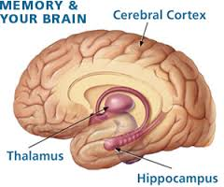
Hippocampus and Stress
PTSD- decreased hippocampal volumes- 5 to 26% decrease
Glucocorticoid receptors eliminate stress response but if there is ongoing stress this elevates receptors and there is a reduction of dendritic branches/ learning
Helps to form and consolidate new memories
Retention is less than a minute
Short term

Slide 15
Working Memory
Complex process
30 seconds/ 4 to 9 chunks
Short term
Powerful predictor of academic success/ more than IQ in the early years
In physical terms, working memory is located in an area about the size of a postage stamp that is located in the right prefrontal cortex, above the right eye and about one inch behind the forehead.

Slide 16
Negative Emotion/ Stress/ Trauma
Stress- lowers serotonin linked to depression
Affects our capacity to think
Trauma affects loss of executive function/ we lose the ability to organize experiences, use our words, and create coherent plans
When triggered , RH reacts as if the trauma is happening right now!
The majority of our most difficult students have developmental history filled with negative experiences.
RH- carries the music of our experiences
It is first to develop
Emotional, visual spatial, reads facial expressions, stores memories of sounds, touch, smells and touch

Slide 17
Trauma/ Adversity
When any circuit fires repeatedly in the brain, it can become the default circuit.
Trauma creates a different blood chemistry and nervous system.
We become stuck in our growth because it is difficult to integrate new experiences.
Amygdala- smoke detector and MPFC- watch tower
There is little to no activation from the MPFC to Posterior Cingulate (our orientation to space- our GPS)
Deactivation of MPFC- loss of purpose, goals and direction

Slide 18
Helping students to activate self-awareness!
Tapping
Kick boxing
Yoga
Choral singing or chanting
Swings
Balance beams
Obstacle course
Stress Response
GAS
Dilation of pupils
Activation of the HPA axis
Growing up in dangerous environments produces toxic levels of Testosterone
Fear and Aggression are contagious and can shape brain chemistry.

Slide 19
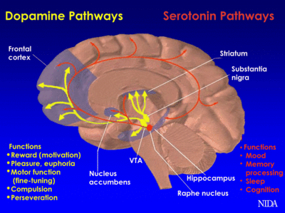
Brains are Records of our Environments
Brain Development increases in complexity and organization as a function of experience.
Learning saves gray matter
Practice thickens white matter
Trauma – a fundamental reorganization of how the brain manages perceptions
We can stay stuck in the chaos we know!
Dopamine is associated with:
Motor Coordination
Working memory
Mental Flexibility
Processing speed
Creativity

Slide 20
Serotonin
High levels of Serotonin- dampen fear response
Low levels- hyperactive to stressful stimuli
Our social environment interacts with brain chemistry
1/ 10 Americans are on anti-depressants

Slide 21
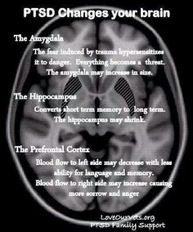
Adversity / Brain
Preverbal
Decreases volume and activity in frontal lobe
Broca’s area goes offline
Broadmann’s Area 19- visual cortex – registers images when they first enter the brain!
RH- carries the music of experience
First to develop
Stores memories of sounds, touch, smells and the emotions they evoke
Cortisol stimulates extra calcium which leads to the production of free radicals in the brain!
Anterior Cingulate- coordinates emotions and thinking
Loss of executive function
When a circuit fires repeatedly a becomes a default circuit
Hippocampus-triggers PNS

Slide 22
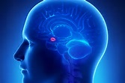
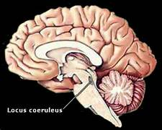
ACE
Attend to the Amygdala
Capture the Trigger
Express
Locus Coeruleus- stress response begins here in the brain stem!

Slide 23
Epigenetic Changes
Every thought creates a biochemical reaction
Signals from the environment activate the behavior of cells and turns genes on or off!
Environment changes function of a cell not the blueprints or sequence
Genes express when cells make proteins!
Chromosomal DNA 2%
Noncoding DNA- responsible for behaviors and personality traits and affected by environment
16 genes expressed differently in PTSD

Slide 24
Social Brain
Two Gifts of the Human Brain!
Malleability of the human brain in early life
Fundamental relational gift of human beings!
Our survival depends on forming collaborative groups
We live, survive and die in groups; we are interdependent
We have to have regulation and rewards in our lives and these are provided by relationships and connections!
The part of our brains that allows us to be human and empathic requires experience to become fully developed and organized!
Our relational neurobiology matters to our mental, emotional and physical health
Dr. Bruce Perry

Slide 25
Social Brain
Forming and retaining relationships / a set of patterned neuronal activity
Our stress responses quiet when we are in a loving positive playful interaction
Adversity will translate into an abnormal organization of neural connections and networks.
Many of our older students have had the same number of healthy social interactions of a five year old!
Top Brain/ Cognition is easier to change
Lower Brain/ Emotion is more difficult

Slide 26
Trauma
Traumatic memories are experienced at a sensory level
Sense of powerlessness
Disconnected from a sense of future
No such thing as resistance- either a child feels safe or does not!
Cortisol stimulates extra calcium which leads to the production of free radicals!
Behind cognitively
Learning networks do not develop or are not as engaged when always attempting to survive which is the primary midbrain experience!
Once the midbrain is not the primary processor of daily life children will often learn three times the rate compared to their non-traumatized classmates!

Slide 27
Adolescent Brain
Emerging sense of self- with self-consciousness
mPFC becomes active when youth think about themselves- peaks at 15 years of age!
Becomes active in social situations as these carry a lot of emotional weight resulting in a self-conscious stress response of high intensity!
The adult brain has grown accustomed to a sense of self!
Teen brain is set up to take risks because this brain shows an increasing response to rewards in areas of pleasure seeking ( nucleus accumbens)
OPFC- activates decision-making, attention and future consequences is underdeveloped! Teens and children areas look the same!

Slide 28
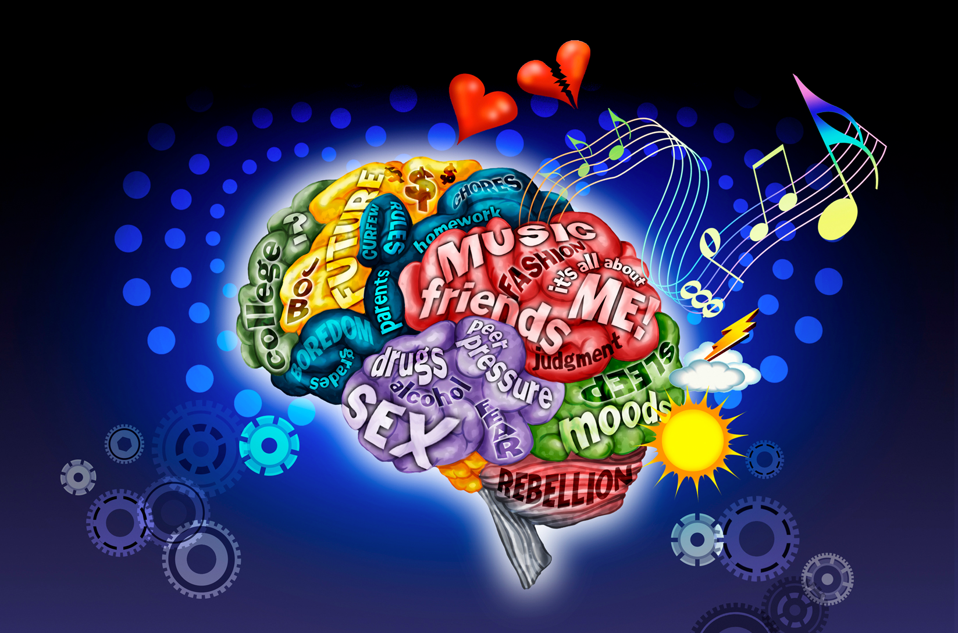
Adolescent Brain
A mature pleasure seeking brain coupled with an immature orbitofrontal cortex means that teens are not only emotionally hypersensitive but less able to regulate emotions!
Who we are as a teen is not simply the result of a choice or an attitude, it is the product of a period of intense and inevitable neuronal change!

Slide 29
Adolescent Brain
Underdeveloped PFC where we plan ahead, impulse control, emotionally regulate, understand consequences
Grow testosterone on the amygdala!
Turn to peers for sense of belonging!
Peer Group-8-25 years (salient group)
6-12- growth spurt of synaptic growth, but then gray matter begins to die out and white matter thickens increasing the safety, permanence, and speed of the axon’s transmission- so we lose capacity but gain efficiency!

Slide 30
Adolescent Brain
Short term goals and motivation are linked to our pleasure and pain centers
Long term motivation is linked to PFC
They process emotions, instruction and procedures from the amygdala!
Always trying to minimize differences
Need sleep! – 9 1/4 hours to produce hormones for growth!
Melatonin is still being produced at 8:30 AM
Before puberty, melatonin shuts down around 7 AM
Reward patience
Socially safe reinforcement
Hone in on social skills, emotional intensity, novelty and creativity!

Slide 31
Neurotransmitters- our chemical molecules!
Nurture can change nature!
Dopamine- our brain saves dopamine for new information instead of wasting it on the same rewards
Mammalian brain scans for potential rewards-feels good so we are motivated.
Expectation of reward stimulated dopamine.
Evolved to release energy to meet a survival need
Dopamine circuits are built from our own past dopamine experiences.
We build dopamine circuits from life experiences
Monkeys with spinach and then juice
Dopamine evolved to store new information about rewards. When there’s no new information, there’s no need for dopamine.

Slide 32
Serotonin
Associated with respect and social status… it is the work horse of neurotransmitters.. Metabolism, sleep
Seeking recognition and status is a part of our survival response as our DNA needs to passed to the next generation
Social Dominance
Survival- more in our digestive systems than in our brains
Ameba- safe to move forward and meet your needs

Slide 33
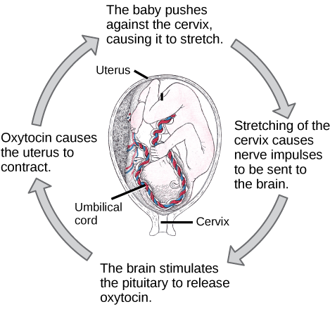
Oxytocin
Social Connection
The more threatened we feel by life outside the group, the more pain you tolerate from within it! Each time you distance yourself from the group, your oxytocin drops and reminds you of the threat of isolation.
We need oxytocin disappointment for our survival!
Bonds of attachment through the years are a build up of oxytocin circuits.
Leaving and joining groups shows a surge and drop of oxytocin.
Those mammals with more social alliances get better mating opportunities and have more survival offspring. When we are connected, we are healthier!
Adolescent - Identity!

