Slide 1
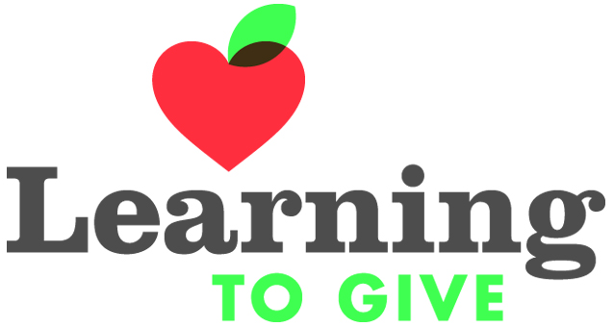
generationOn Indiana
Developing Social/Emotional Skills Through Service-Learning
Presented by Beth Smith – genOn IN School Consultant
Joan Belschwender – Director genOn IN

Slide 2
Staff Introductions
Joan Belschwender - Director of generationOn Indiana generationOn@iasp.org
Retired teacher in 2010 – Taught 34 years in MSD Warren Twp. , Indpls.
Beth Smith –generationOn Indiana School Consultant
bethsmithgenonin@iasp.org
Teacher for 31 years in private, faith based school; inner city public school; suburban public schools
Team Leader; building autism coordinator; gifted and talented education; special education license; general education license; Teacher of the Year for IPS; State of Indiana Teacher of the Year Finalist
Darlene Short – Teacher Castle North M.S/ genOn Southern IN Field Rep dshort@warrick.k12.in.us
Jack Birmingham – Asst. Superintendent Union Twp. Schools/ genOn Northern IN Field Rep jbirmingham@union.k12.in.us
Todd Bess- Executive Director IASP and genOn IN facilitator
Shirley Wright – Executive Director IMLEA and genOn IN facilitator and co-coordinator

Slide 3
Resource Introductions
generationOn Indiana
Grant funded program facilitated by the IASP (Indiana Association of School Principals) and the IMLEA (Indiana Middle Level Education Association) to support and assist educators and youth development professionals in Indiana with FREE service, service-learning, and philanthropy education lessons and resources from generationOn and Learning to Give.
generationOn www.generationOn.org
Our vision: A world where all young people have the opportunity to make a positive mark on the world.
Our mission: To provide programs and resources that support the development of caring, compassionate and capable kids and teens through service, empowering them to become changemakers in their communities and the world.
Learning to Give www.learningtogive.org
Our mission is to provide quality, inspirational, and field tested tools to help K-12 teachers educate, equip, and empower their students to be giving and caring citizens. Imagine a world where all youth are knowledgeable and equipped for lifelong engagement in philanthropy as givers of time, talent, and treasure for the common good.

Slide 4
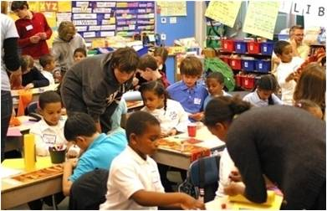
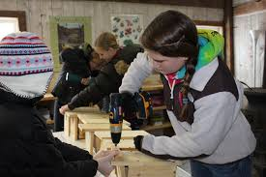
Service, Service-Learning: What is the difference?
Service-Learning is…
Service is…
volunteer action to meet the needs of others or for the common good.
a research-based teaching and learning strategy that engages youth in service to meet learning objectives and address real-world issues through service.
Notes:
generationOn Schools support the development of 21st century skills and social responsibility through the teaching strategy of service-learning. Now, many schools have a long tradition of doing service projects to benefit their community or an organization. Often school-based service takes the form of fundraising or drives. While certainly valuable, service, or volunteer action to meet the needs of others or for the common good, does not in itself contribute in a significant way to the goals of a school, namely academic student learning.
Service-learning, on the other hand, is a research-based teaching and learning strategy that engages youth in service to meet learning objectives and address real-world issues through service. Service-learning is not an add-on, but just good teaching – meeting academic standards, providing opportunities for real-world applications of learning and contributing to students socio-emotional development.

Slide 5
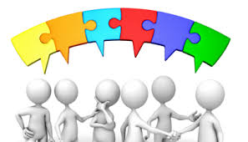
Advantages of Incorporating Service-Learning
Service-learning promotes access to the general education curriculum and promotes higher engagement and achievement.
Promotes generalization of skills by connecting curriculum content with real-world settings/activities
Develops critical and creative thinking skills
Builds positive character, cooperation and collaboration skills, leadership, and social skills
Develops empathy and promotes globally aware and concerned citizens
Creates community collaboration with schools and students with special needs while building mutual positive relationships
Allows for correction, multiple trials, and reflection

Slide 6
Why Philanthropy Education
Students exhibit more charitable beliefs, attitudes, and behaviors
Builds ownership and “Why Serve?” of service-learning
Gives a deeper purpose for learning – students recognize talents and skills to “make a difference”
Increases student motivation to attend school
Improves school culture
Community sees youth as an asset rather than a liability
Practice different habits of life-long philanthropy
Broadens perspectives or career opportunities
Develops critical thinking and leadership

Slide 7
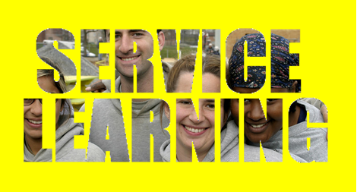
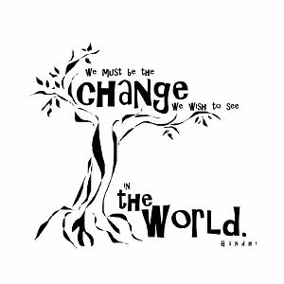
Time, Talent, and Treasure
Service-Learning fits in so well with what you are already doing!
Through the Learning to Give lessons, students
will be introduced to the concept of philanthropy, evaluate the role of philanthropy in the smooth functioning of government and describe the role of families in shaping a democratic society.
become acquainted with the tradition of giving and its impact on the exercise of responsible citizenship. With this multiple perspective, students will define the basis for their own responsible civic behavior.
develop an understanding of the importance of participating in active citizenship through their contributions to society
gain a better understanding of how individuals within the community work for the common good

Slide 8
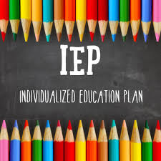
Service Learning and the IEP
Service-learning provides:
Opportunities for academic, social, and life skills instruction in a real-world setting
Opportunities for community-based instruction in an inclusive setting
Natural setting for character education and social skills acquisition and practice
Opportunities for functional activities that are inherent in many of the service-learning opportunities: i.e. – a clothing drive allows for students to sort, wash, fold and iron the donated items for distribution
Incorporates and improves technology skills

Slide 9
Sample IEP Goals*Addressed through Service-Learning
Demonstrate appropriate peer relationships, cooperative learning, and assertiveness
Make appropriate decisions on a daily basis
Develop social understanding skills
Increase social communication skills
Demonstrate problem-solving skills
Transition effectively between activities in the school and the mainstream
Maintain and improve appropriate social skills in school and mainstream
* Add setting, benchmarks, criteria for mastery, method for evaluation, and evaluation schedule

Slide 10
Service-Learning and Functional Skills
Service Learning supports all of the key components of a functional curriculum: home, self help, employment, recreation, community involvement, health, and functional academics
Students practice and improve skills of collaboration, organization, planning, and implementation
Reinforces social interaction in a generalized setting
Utilizes community-based instruction in a natural way
Teaches financial literacy: funding and budgeting, etc.

Slide 11
Transition Assessment and Preparation
Service-learning provides:
Opportunities for students to explore and identify interests
Informal and formal assessments of students in a natural setting
Opportunities to develop work knowledge and skills
Opportunities to develop and practice functional life skills
Opportunities to develop social skills
Students are involved in their community in a positive way and have opportunites to generalize acquired skills

Slide 12
Social/Emotional Behaviors Addressed Through Service-Learning
Adjusting to environmental changes
Peer interaction
Handing of new situations
Involvement in per group activities
Recognition of emotions
Physical self-control
Coping with frustration
Self-assertion
Understanding strengths and weaknesses
Demonstration of trust
Self-awareness
Verbal introductions
Accepting consequences of actions
Giving assistance
Appropriate Attention
Coping with demands of a variety of settings
Working in a group on a common goal
Independent task completion
Accepting assistance from others

Slide 13
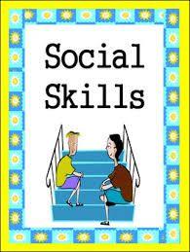
Social/Emotional Behaviors (continued)
Self-esteem
Greetings
Self-confidence
Turn taking
Acceptance of defeat
Sharing materials
Tolerating frustration
Initiating peer interaction
Pride in accomplishment
Initiating adult interaction
Self-control
Eye Contact
Self-determination
Physical proximity
Self-advocacy
Facial Expressions
Courtesy
Compliance
Tact
Responsibility for own actions

Slide 14
The Six Steps of Service-Learning
Investigation: Matching student passions and community needs.
Preparation: Getting ready for service through learning.
Action: Service – Direct, Indirect, Advocacy or Research
Reflection: Making meaning through multiple modes.
Used throughout the process
Demonstration: Public display of the process and impact of service-learning.
Evaluation: Assessing students’ learning and service.
There are professional development modules and documents on the website that explain these steps in detail. Downloadable and Printable templates to use with your students. Log into your account to access this website page: http://www.generationon.org/educators/lessons- resources/iparde
Notes:
Beth – 3 minutes highlighting the process IPARDE - As you see, service-learning is not a one-off service project, but a process. This process is known by the acronym IPARDE. There are six stages to the service-learning process, each important in its own way, and each contributing to academic learning, skill building and the development of citizenship, social responsibility and a sense of empowerment. While the stages are typically represented linearly, they do not necessarily go in order – in fact many times the stages happen concurrently.
Let’s quickly see what those stages are (click for stages to fade in). Investigation, Preparation, Action, Reflection, Demonstration and Evaluation. You can see the quick definition for each of these stages here. We’ll take each on and provide a little more detail in the following slides.
Distribute IPARDE handout

Slide 15
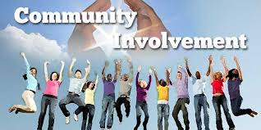
Community Partners
Assess your current resources- who is already involved/invested
Look for additional resources and take the first step – reach out
Look for long-term relationships and partnerships
Don’t count anyone out
Stress the benefits and the win/win scenario
Be creative and think outside of the box!
Engage students in outreach!

Slide 16
generationOn website
generationOn is the Youth Division of Points of Light Enterprise, which is the world’s largest nonprofit focused on volunteerism and service.
www.generationOn.org – Free online service and service-learning resources for many audiences: Kids, Teens, Educators, Parents, Organizations, Clubs
The mission of generationOn is to inspire, equip, and mobilize youth to take action that changes the world and themselves through service. – Overview handouts on generationOn, generationOn Schools, genOn Service Clubs, and Service-Learning Resources available.
Notes:
Joan 8 minutes going through the website offerings and generationOn Clubs

Slide 17
Learning to Give Website
Philanthropy Education Lessons – Over 1700 teacher created K-12 lesson plans* to inspire and equip students who use their hearts and minds to impact their world. Magnify the impact of any academic content with themes of generosity, community, and civic/social responsibility. The lessons are a perfect base for service learning, PBL, and student-centered instruction.
www.learningtogive.org
*LTG Lessons can be linked to standards, existing curriculum, Project Based Learning and STEM

Slide 18
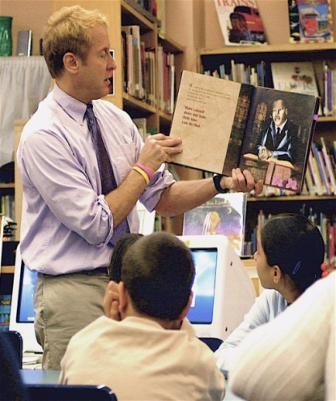
Website Tours
generationOn www.generationOn.org
Register yourself
Tabs for different audiences.
Kids – Elementary age
Teens – Middle and High School
Parents and other Caring Adults
Educators
Organizations
Clubs
Learning to Give
www.learningtogive.org
1,700+ lesson plans searchable by:
Grade level
Subject
Keyword
Standard (state or common core)
Theme
Calendar Event
Monthly Moments of Service
Professional Development- mini courses
LTG Teacher Profiles
Notes:
–
Learning to Give, the curriculum division of generationOn can help you access lessons to support the academic learning of your service-learning experience. We have over 1600 lessons on our site, and all lessons are aligned with state and common core standards. And they all promote responsible citizenship and taking action for the common good. We show you here the ways you can search for lessons.
All of our lessons are based on a K-12 philanthropy framework with themes that teach youth about our civil society and democracy, rights and responsibilities, the diversity of needs and ways to address them, the history of philanthropy, and the benefits to themselves and others of giving their time, talent and treasure for the common good.

Slide 19
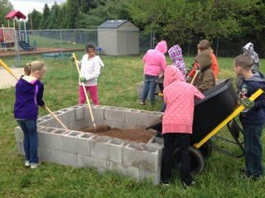
generationOn Online Resources – www.generationOn.org
Service-Learning Resources and Templates – Educator Tab
Service project ideas and plans – Kids and Teens Tab
Do Your Own Thing! Guides for Kids and Teens to plan and implement service –learning projects
65 Ways to Make a Difference
Service and Service-Learning Online Trackers – on your registered account
generationOn National website campaigns and grant opportunities – Example: The JoyMaker Challenge; Rules of Kindness, Make Your Mark, Family Volunteer Day
Monthly philanthropic themes
Register as a generationOn School
Register a group of students for a genOn Service Club

Slide 20
Learning to Give Online Resources – www.learningtogive.org
Google Search Box on LTG main page - Search over 1700 K-12 philanthropy education lessons
Search Lessons by Key Word, Grade level, Subject, and more filters.
Check out the main page and the 4 main tabs
Teach - Issue Areas, Lessons, Courses for Independent Schools, Youth Activities, Briefing Papers, Literature Guides
Get Started - Teach One, Plan Giving Instruction through Your Calendar, Fisher Online Institute- mini courses
About - Why Philanthropy Education and about LTG
Partners - Campaigns and mini-grant opportunities
Free e-newsletter sign up
Trending – LTG news
Create an Account to share your stories with LTG

Slide 21
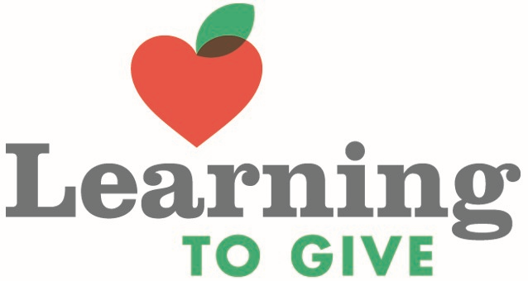
Plan Giving Instruction
Plan Giving Instruction through Your Calendar
Lessons and Teaching Resources by month- A calendar-based menu of resources that aligns philanthropy and service with your content and seasonal planning. Add service to your calendar and maximize teachable moments.
August –
Introduction to Philanthropy Lessons
Character Education Lessons
Establishing a Culture of Kindness
Anti-Bullying Lessons

Slide 22
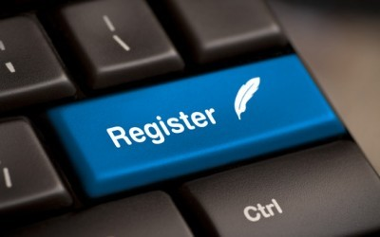
Benefits of registering yourself and your school:
generationOn and LTG e-newsletters and monthly updates from genOn IN with Lesson suggestions and monthly Moments of Service.
Access and download anything on the website.
Eligible for mini grant opportunities
Technical Assistance from generationOn Indiana
Joining your school account will allow you access to the online Schools Service-Learning Tracker to submit service learning projects, tell your service story, measure impact, and document learning outcomes
Free PD from genOn IN

Slide 23
Mini-grant opportunities – from genOn IN
generationOn Indiana mini-grants – see handout
$250 mini-grants for teachers in Indiana schools to support service-learning projects.
The LIVE LINK to this online application is emailed to you from Joan Belschwender generationOn@iasp.org after you register. You will NOT find this on the generationOn Website
-These mini-grants are funded by Lilly Endowment, Inc. and facilitated by IASP.
Mini-grant requirements:
Teacher must be registered on the website so you are on our genOn IN database and have a generationOn account
Use a Learning to Give lesson with the students,
Submit the data from the project on the service- learning tracker on your generationOn account.
Notes:
Joan speaks about the mini-grants and the application process – 5 minutes

Slide 24
generationOn Service Clubs
Kids Care Clubs – Elementary School Children (ages 5-10)
Service Clubs – Middle and high school students ( ages 11-18)
Clubs receive:
Facilitator Handbook
Monthly Newsletter
Project Guides
Fact Sheets
Lesson Plans
Youth-Centered Project Planning Material
Grants and Opportunities
Technical Assistance and Training
Tracking and Evaluation
Go to www.generationOn.org/clubs to register your new club!!

Slide 25
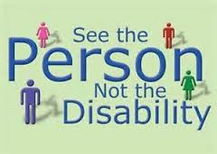
Disability Awareness for Peers
Everyone is Special – Grades K, 1, 2
www.learningtogive.org/units/philanthropic-literature/everyone-special
To expose students to literature which reinforces the concept of tolerance toward people who are different. (The focus is on special-needs persons.) This lesson will also relate tolerance to becoming a responsible citizen.
What Respect Means to Me -Grades 3,4,5 https://www.learningtogive.org/units/what-respect-means-me
Students develop and practice respect for self, others, and the environment. They create good habits of respect, show acceptance for diversity, and learn positive self-talk. They define disrespect and teach others the consequences of bullying.

Slide 26
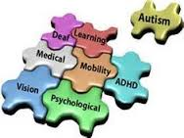
Disability Awareness for Teens
Center Stage – Focus on the Mentally and/or Physically Challenged
www.learningtogive.org/units/setting-stage-service-learning-relationships/center-stage-focus-mentally-andor-physically
Students will be engaged in reflection of stereotypes, prejudice and discrimination related to physical and/or mental challenges. From a cognitive and affective perspective, students will be involved with activities to assist them in developing sensitivity to working in direct service projects with individuals who are physically and/or mentally challenged. Subsequently, students will also generate guidelines for positively and sensitively working with these individuals. Conduct/proper etiquette, as well as appropriate conversation, will be addressed.
Stand and Deliver for Justice and Diversity – Grades 9,10,11,12
www.learningtogive.org/units/stand-and-deliver-justice-and-diversity-10th-grade
Learners explore and share their attitudes about diversity and issues of justice and kindness. The learners brainstorm ways that they can promote the common good by working to eliminate stereotyping, intolerance, discrimination, and prejudice.

Slide 27
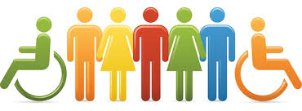
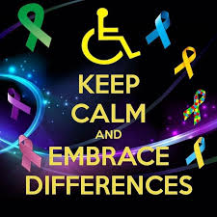
Disability Awareness Toolkit
www.learningtogive.org/resources/disability-awareness
Lesson Plans
Types of Service Projects
Project Ideas
Making Inclusion a Priority

Slide 28
Professional Development on Learning to Give
Earn FREE Professional Development points while learning about philanthropy education and its benefits! https://www.learningtogive.org/courses
Learn through Mini-Courses at Your Desktop!
The Fisher Educator Mini-Courses provide online professional training in philanthropy education and service-learning. In your own time and at your desktop, learn methods of thoughtful service-learning, history, practice, and benefits of philanthropy. Participants earn certificates that may be applied toward professional CPE credits.
Three types of courses:
Understanding Philanthropy
Service-Learning Practice and Projects
Using Website Resources

Slide 29
Northridge Middle School Ability Day

Slide 30
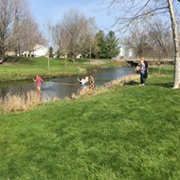
Northridge Middle School Riverbend Lab

Slide 31
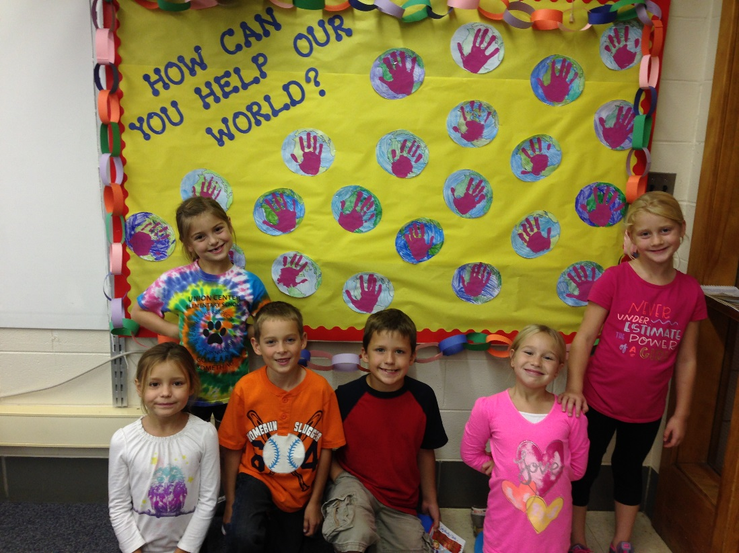
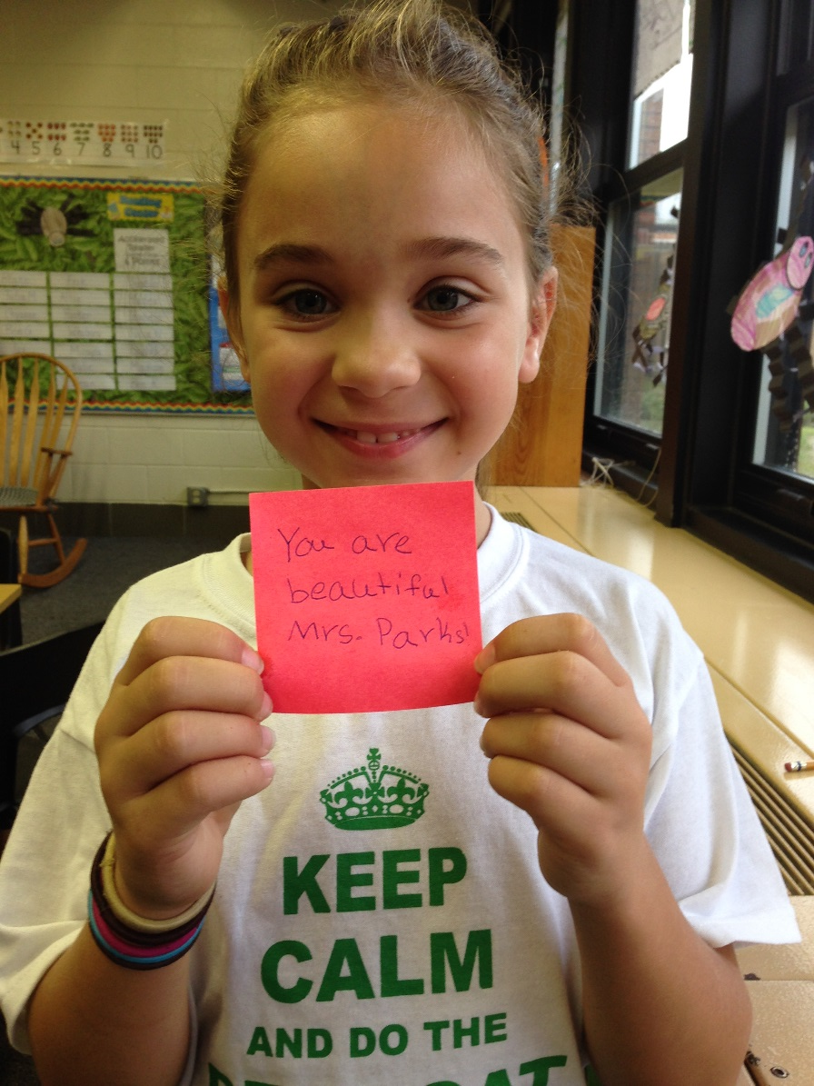
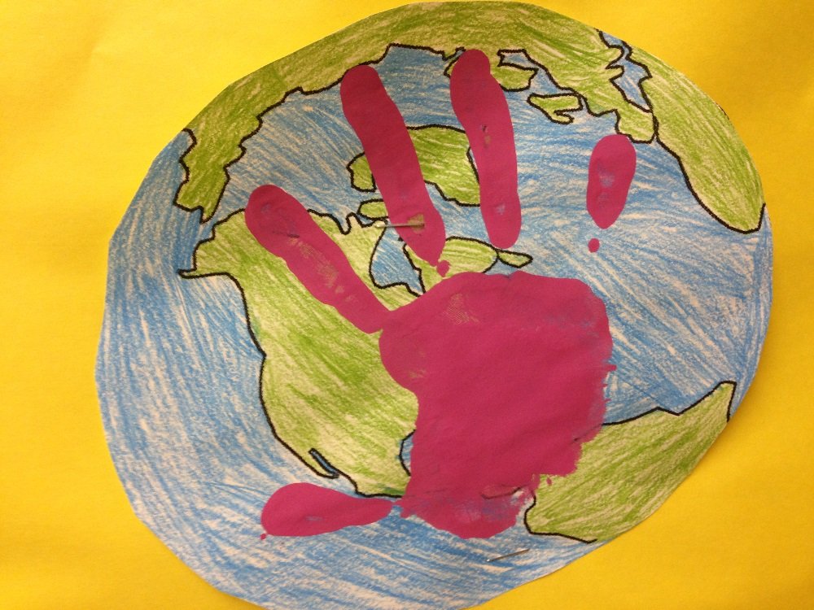
Union Center Elementary School
What has Mrs. VanBeek’s second grade done thus far??
Cleaned up the playground.
Wrote encouraging notes to the teachers. Positive school climate (photo)
Decorated the computer lab for the school

Slide 32
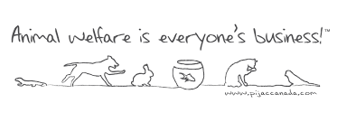
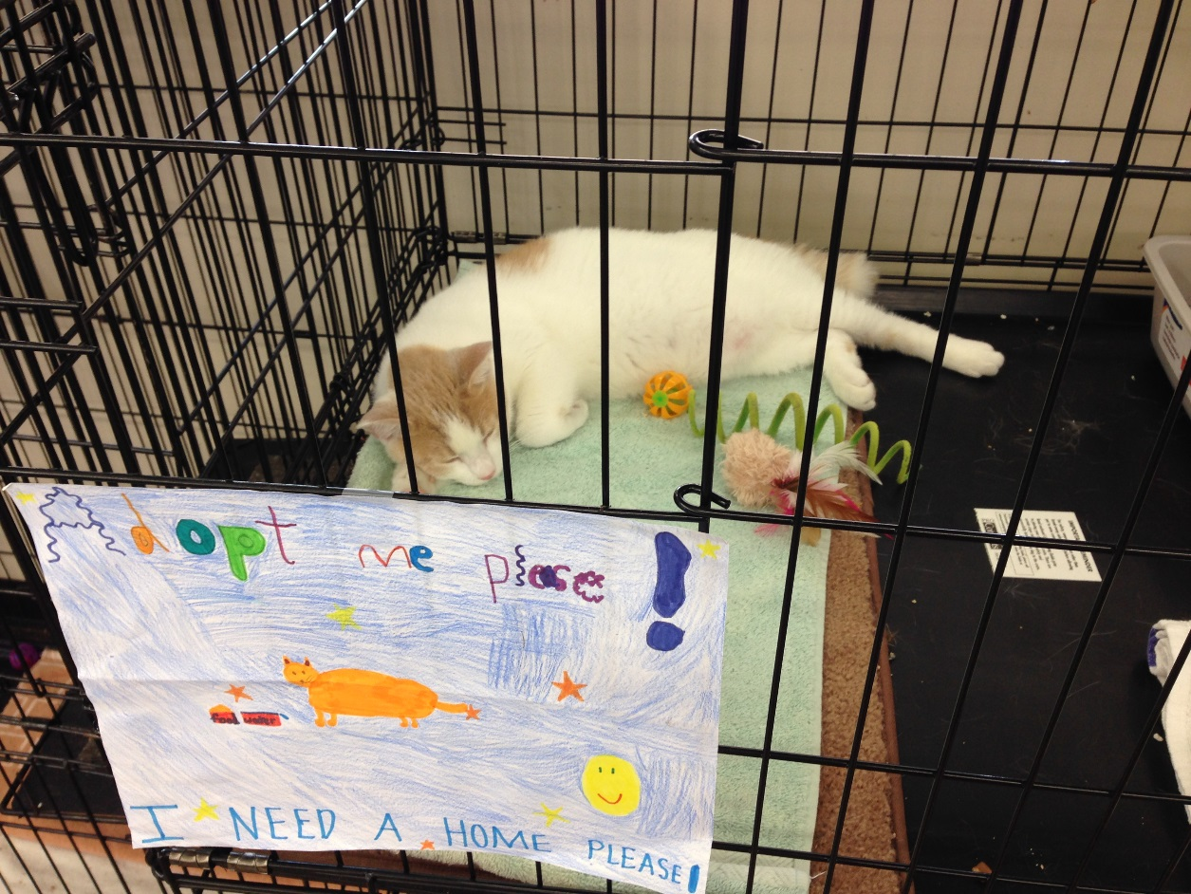
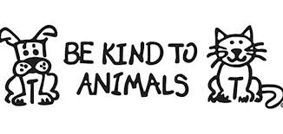
Union Center Elementary School
Made posters for the animal shelter
to increase the odds for adoption

Slide 33
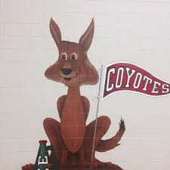
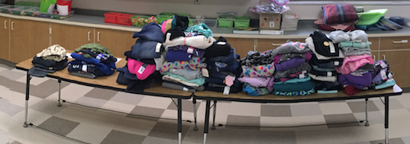
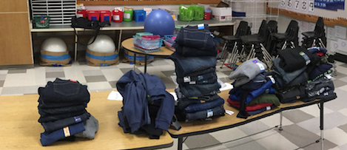
Jay Lovell Sugar Creek Elementary School
Winter Warm Up Project
Why do we Give? What is Philanthropy?
Students advertised and promoted the clothing drive
All recipients were completely outfitted
Enough donations were collected to create a “Clothing Pantry”

Slide 34
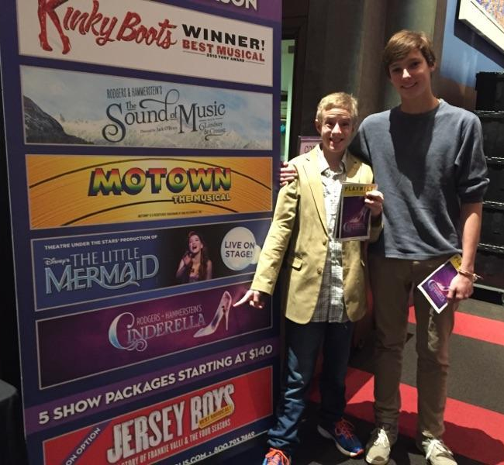
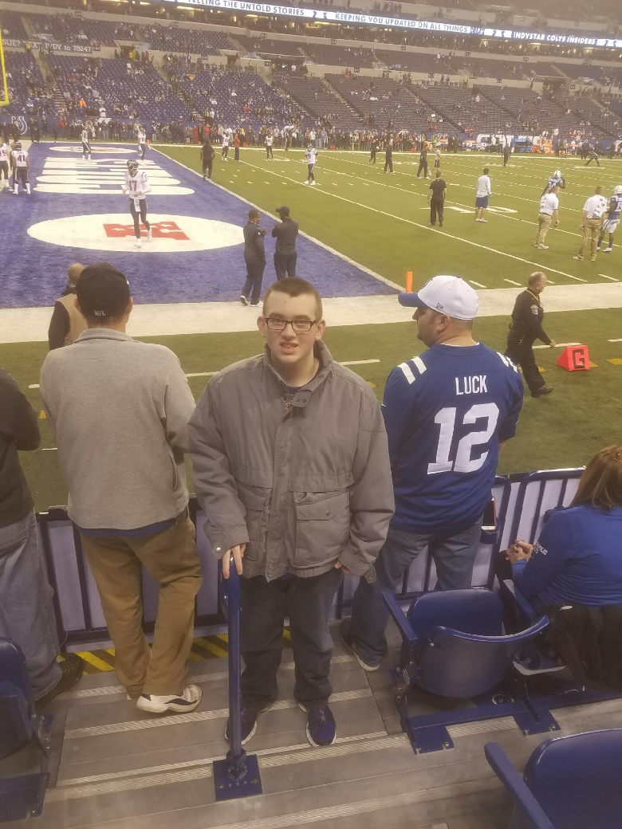
Wishes- New Palestine High School

Slide 35
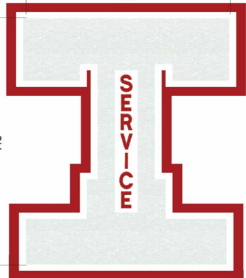
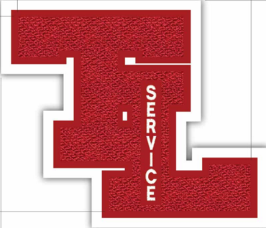
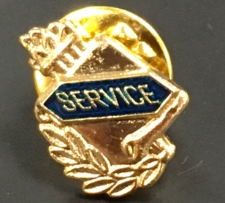
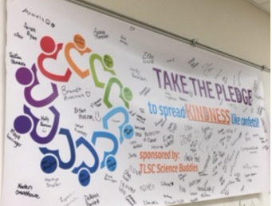
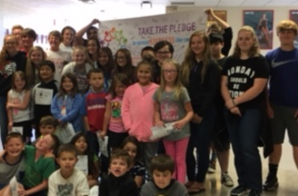
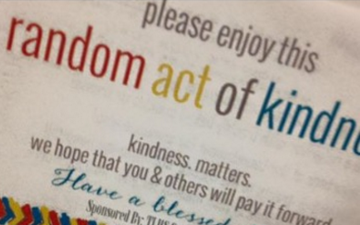
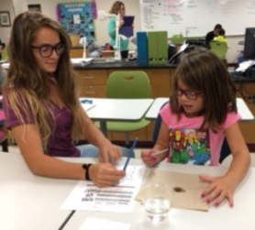
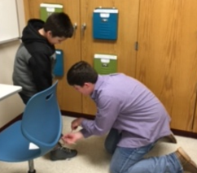
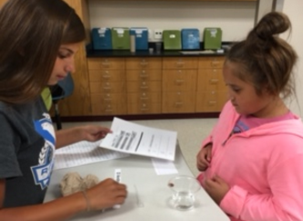
classroom teacher/aspiring administrator
*Varsity Service Letter
-145 service hours
-Reflection Video
*Science Buddies
-Pay it Forward Day
-Learning to Give
https://www.youtube.com/watch?v=RQwPb6OW0G4&list=PLCU2ffYkjU78dh8Ws0zBXUpSf_-xNlNxl&index=12

Slide 36
Project Highlights
Check out these project ideas! Which ones could work for you and your school?
“Adopt Me “ bandanas Help Keep our Parks Clean
Make dog treats for shelters Promoting Positive Body Image
Living History “Meals on Wheels”
Friendship Bench “Bake a Difference”
Photojournalism for Good Cards for Troops
Earth Day Boxes of Love
Service Stories- on “Track and Share”

Slide 37
Thank you!
Contact information:
Joan Belschwender :Director, generationOn Indiana 317-891-9900 X201
generationOn@iasp.org
Beth Smith : Consultant 317-370-7168
bethsmithgenonin@iasp.org
Hope to see YOU Registered Soon !!!
Notes:
Joan wraps up the session – questions and thank yous

