Slide 1
Christy Gauss, Project Coordinator Indiana School Mental Health Initiative Dr. Cathy Pratt, BCBA-D Director, Indiana Resource Center for Autism Kristan Sievers-Coffer Indiana Department of Education
Indiana School Mental Health Initiative

Slide 2
Indiana School Mental Health Initiative: Our Vision
Concerns
Our Approach
Hoped for Outcomes

Slide 3
Indiana School Mental Health Initiative: Activities
Behavior Consultants Community of Practice
System of Care Connection: Examples of Success
Conferences: Ross Greene, Bruce Perry
Videos
Articles
Regional Workshops
Two-Day Intensive Workshop
Demonstration Sites/Leadership Group: Using Model of Collective Impact
Policy Work
Social Networking
Stigma Work

Slide 4
Indiana School Mental Health Initiative: SHAPE
What is SHAPE?

Slide 5
The School Health Assessment and Performance Evaluation (SHAPE) System is a free, interactive system designed to improve school mental health accountability, excellence, and sustainability.
SHAPE is the web-based portal by which comprehensive school mental health systems can access the National School Mental Health Census and Performance Measures.
SHAPE is hosted by the Center for School Mental Health and funded in part by the US Department of Health and Human Services.
www.theshapesystem.com
Notes:
The SHAPE System was developed by the National Center for School Mental Health at the University of Maryland School of Medicine with funding from the U.S. Department of Health and Human Services, Health Resources and Services Administration, Maternal and Child Health Bureau

Slide 6
Schools and School Districts Can Use SHAPE To:
Document their service array and multi-tiered services and supports
Advance a data-driven mental health team process for the school or district
Strategic Team Planning
Free Custom Reports
Access targeted resources to help advance your school mental health quality and sustainability

Slide 7
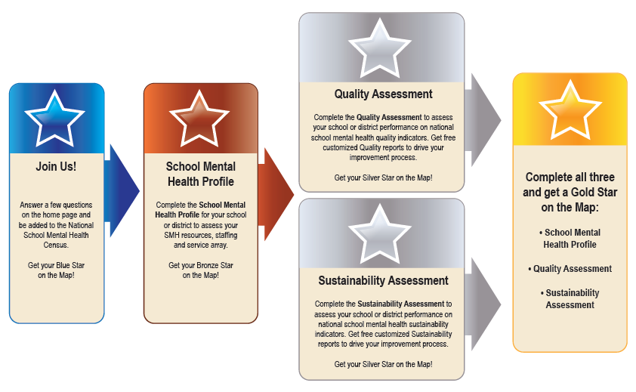
Schools and School Districts Can Use SHAPE To:
Achieve SHAPE Recognition to increase opportunities for federal, state and local grant funding
Notes:
By participating with The SHAPE System your school and district will achieve SHAPE Recognition to increase opportunities for federal, state and local grant funding. Our state is strongly encouraging schools and districts to use the SHAPE system and achieve Silver Star Status.

Slide 8
Why would a district use SHAPE?
Districts that:
want to document what mental health services they have across tiers of support in the district
need a uniform quality improvement process process to understand school mental health strengths and needs throughout the district
would like to standardize the process of school-community mental health partnerships in their district, while still allowing schools to individualize services to their needs
Notes:
Here are some more specific benefits of SHAPE for a school district. SHAPE is NOT an add-on but is meant to be used to incorporate students’ social, emotional, mental health into existing school quality improvement plans and frameworks (MTSS, PBIS, etc).

Slide 9
Why would a school use SHAPE?
Schools that:
want to document their school- and community-employed mental health staffing
need to identify what services they have for specific problem areas across a multi-tiered system of support (MTSS)
are interested in improving their universal screening practices, but don’t know where to start
would like to better partner with community mental health providers, but want to be sure that added services meet needs, and are complementary with and augment existing staff supports

Slide 10
Available this Fall
Access to a Trauma Responsive School (TRS) Implementation Assessment
Access to a Screening & Assessment Repository (mainly low cost to no cost list of instruments)
School Mental Health Playbook to assist schools with implementation

Slide 11
TRS Assessment
Developed in partnership with National Child Traumatic Stress Network
Domains (all items on a 6-point Likert scale reflecting degree of implementation):
School-wide Safety
School-wide Programming
Staff Trauma Knowledge
Staff Trauma Skills
Early Intervention Activities
Staff Wellness/Burnout/Secondary Traumatic Stress

Slide 12
SMH Playbook
What is a playbook?
Repository of information that schools and districts can reference for guidance and strategies to improve school mental health quality and sustainability
Detailed implementation guide containing tested strategies (EBP and improvement/innovation “practice-based evidence” from the CoIIN)
Notes:
CoIIN: Collaborative Improvement and Innovation Network

Slide 13
More questions about SHAPE?
Christy Gauss, MSW
Indiana School Mental Health Initiative, Indiana University Bloomington
jcgauss@Indiana.edu
317-908-0988
Dr. Elizabeth Connors
Center for School Mental Health (CSMH), University of Maryland
econnors@som.umaryland.edu
410-706-1456
Kristan Sievers-Coffer
Special Education Specialist
Indiana Department of Education
ksievers@doe.in.gov
(317) 232-0580
Jeff Wittman
School Social Work & Foster Youth Specialist
Indiana Department of Education
jwittman@doe.in.gov
(317) 234-5704
Notes:
Please contact the Center for School Mental Health or our state leadership for any questions about SHAPE!

Slide 14
Indiana School Mental Health Initiative: Our Vision
Questions?
Recommendations?
Ideas?

