Slide 1
Put On Your Oxygen Mask! The Brain, Behavior, and Learning
Dr. Lori Desautels
Butler University/ College of Education
ldesaute@butler.edu
Revelations in Education
Desautels_phd

Slide 2
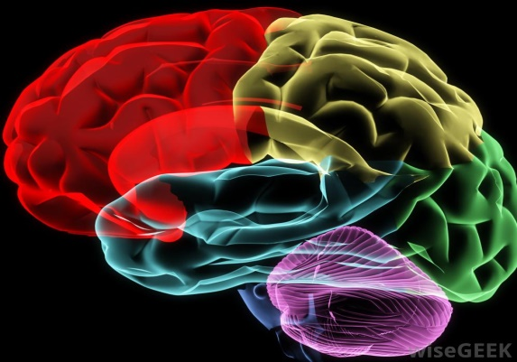
Oxygen Masks/ We’re Flying in High Altitudes!
Instead of asking, “What is wrong with this student?” We want to ask, “What happened to this student? What is the story of this student? ”
Educational Neuroscience
Brain is built for connection, survival, emotions and learning!
Social Organ
Survival can look selfish, disrespectful, aloof, hostile, and violent

Slide 3
Stress/ Adversity
Neuro-anatomy
Everything is perception!
Survival Brain
Chronic Stress changes the brain!
Early experiences have a far greater impact than later ones!
Impact of Stress/ Our personal relationship with stress
Modern society mass produces disconnected children – our nuclear family is much smaller and peers, social media and being isolated account for 93% of our interactions…

Slide 4
Brain Architecture
If you lack a deep memory of feeling safe and loved, the receptors in the brain that respond to human kindness fail to develop!
If we feel safe and loved, our brain specializes in collaboration, play and cooperation.
If we are constantly feeling unloved and unsafe, then our brain specializes in managing feelings of fear and abandonment

Slide 5
Survival Brain
When we are living in survival mode, with our stress response turned on all the time, we can really focus on only three things!
Body: Am I ok?
Environment: Where is it safe?
Time: How long will this threat be hanging over me?

Slide 6
Addicted to Emotions! Trauma is Inherited
Cells will eventually require an intensity of emotion to open their receptor sites/ the body will require a greater chemical thrill to turn on the cell. For the body to become stimulated, and get its fix, we will need to get angrier, more worried, guiltier.
When the body isn’t getting its chemical emotional needs met, it will signal the brain to make more of those chemicals!

Slide 7
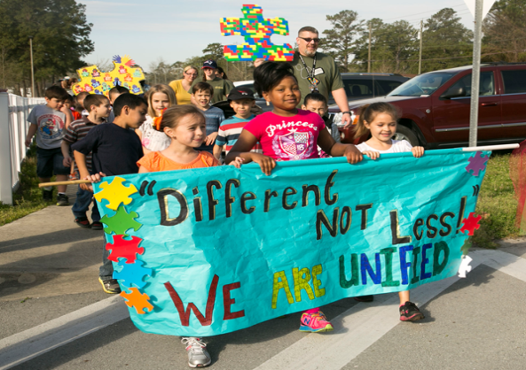
ASD
Pockets of Strength
Everyone is on a continuum of thought, behavior and emotion
Competence happens in different environments
Focus on details
Great memory for certain details
Ability to focus through the emotional rubble!
What is this “specialized mind?”
Temple Grandin- “There is detailed information on this fire hydrant! “

Slide 8
Questions that Shift Perspectives
Am I important to someone here?
Can I share my gifts with someone here?
Can I influence my world here?
Are my efforts recognized here?

Slide 9
For All Students!
Identify triggers
Build on areas of Strength
Capitalize on interests
Capitalize on learning!
How are you smart?

Slide 10
Attachment
Attachment and the Brain
Safety
Emotions are contagious
Children and youth who have experienced adversity have a higher concentration of brain cell growth in the midbrain. They are oversensitive to perceived threats and have lower levels of serotonin, which is linked to anxiety, depression, and aggression!

Slide 11
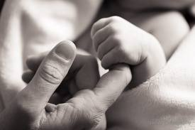
Neural Tissue and Teaching?
Memory, neural tissue and development all change with patterned repetitive activity! The systems in your brain that get repeatedly activated will change. This experience-dependent development is one of the most important properties of neural tissue!
Early experiences with others mold our world views-negative or positive! These are our memory templates.

Slide 12
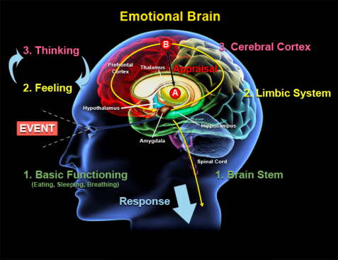
Fear and the Brain
Fear affects all parts of the brain
We are feeling creatures who think!
Brain doesn’t know the difference between a thought of the trauma or the actual adverse experience!
Shame: What is this? Beneath all violence!
We tend to prefer the certainty of misery to the misery of uncertainty! As teachers we see this and do not understand!

Slide 13
Brain and Adversity
The very same capacity that allows us to bond with one another also allows us to collaborate to defeat a common enemy. What permits us to perform great acts of love, also allows us to dehumanize others who are not like us or are not a part of our clan. This tribalism can result in the most extreme forms of hatred and violence!
Environments and neurological state of mind are intimately connected
Attachment is the carrier of all development!
The majority of your most difficult students have a history filled with negative experiences! School history may be filled with referrals, punitive interventions, and sustained failure.

Slide 14
Perception
Same thoughts
Same choices
Same Actions/ Behaviors
Same Feelings
Same brain activity which activates the same brain circuits, and reproduces the same brain chemistry in the same way.
The same brain chemistry signals the same genes
Same gene expression creates the same proteins, the building blocks of cells which keep the body the same as the proteins are the expression of life and health… literally!

Slide 15
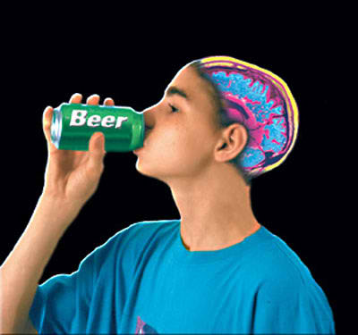
Adolescent Brain
Increased levels of dopamine
Lower baseline for dopamine
Gray and white matter
Identity
Peers
The third type of behavior shaped by the increased reward drives of the adolescent brain is something called hyperrationality. This is how we think in literal, concrete terms. We examine just the facts of a situation and don’t see the big picture.
Less serotonin and more testosterine

Slide 16
Identity in Adolescence
Emotional Spark
Social Engagement
Novelty seeking
Creative Explorations
Grows from the inside out and from back to front!
3 Years Old: 90% of adult size!
10–14 years of age: Second greatest time of brain development! Our middle school students need more emotional support than we ever thought!
Executive Functions
Development is messy!

Slide 17
Connection/ Relationship
Built in attachment programs which strongly motivate us to seek out positive bonds with caring adults!
All behavior is communication / function
Children and adolescents will always look misbehaved before they look stupid!

Slide 18
What can we do?
Stress response changes neural circuitry
Amygdala doesn’t respond to words- feelings!
To co-regulate is fundamental to discipline and deep understanding and behavioral changes

Slide 19
Discipline! A New Neural Path!
Movement , Space and Breath! Focused Attention Practices
Drawing and Coloring
Validation
Power of Questions
Emotional First Aid Kit!
Choices
Service to Another
Connection Journals

Slide 20
Head Quarters!
Core Memories?
Train of Thought?
Islands of Personality!
Emotional Contagion
Forced Success
Dual Thought Sheets
Stories/ Nellie
Hero's Journey

Slide 21
Strategies
Teach students about their brain’s neuroplasticity
Routines and rituals- change them up/ Bell Work
Notice Everything
Create class guidelines
( agreements) together and change them often!
Stories, Images
Everyone will get what they need!
Co-Teach and Co-Design Lessons
Validation and the power of Questions
What homework did you do for your students this week?
Focused Attention Practices

Slide 22
Questions and Validation
How can I help?
What do you need?
Do you have a plan?
How can I help you?
What are your resources?
What feels difficult?
What could be the best possible outcome?
What is the worst thing that could happen?
What is a first step in improving this situation?
That must have made you feel really angry.
What a frustrating situation to be in!
It must make you feel angry to have someone do that.
Wow, how hard that must be.- That’s stinks!-
That’s messed up!
How frustrating!
Yeah, I can see how that might make you feel really sad.
Boy, you must be angry.
What a horrible feeling.
What a tough spot.
I hear you.
I hear that.
Other…

Slide 23
Level the playing field!!
Dual Thought Sheets
What is our challenge?
What led up to this challenge?
How did we handle this together and /or apart?
Could we have prevented this problem?
What are two adjustments we will make the next time?

Slide 24
Connect with me!!!
To understand our neurobiology is to know the secret of life!
https://www.facebook.com/lori.l.desautels
Desautels_phd
ldesaute@butler.edu
www.revelationsineducation.com
Desautels_phd - twitter handle
"Who are YOU?" said the Caterpillar.
This was not an encouraging opening for a conversation.
Alice replied, rather shyly,
"I-I hardly know, sir, just at present - at least I know who I WAS when I got up this morning, but I think I must have been changed several times since then." - Alice's Adventures in Wonderland, Lewis Carroll

Slide 25
Thank you!!!!

